Slide 1
Test Stand Design for magnets and SRF cavities
Ram C. Dhuley (updates by Greg Tatkowski)
USPAS – Cryogenic Engineering
February 3 – February 7, 2025

Slide 2
Content courtesy
Tom Peterson of SLAC, USA
  For much of the material on VTS and HTS test stands
Andrew May of STFC Daresbury, UK
  For material on horizontal VTS at STFC Daresbury

Slide 3
Outline
Test dewars and test stands for SRF cavities and magnets
  Vertical test stands
    Saturated bath test dewars
    Double bath test dewars
  Horizontal test stands
  ‘Horizontal’ vertical test stand
  Cryogen-free test stand
Procurement and operations

Slide 4
Saturated vs. subcooled helium bath
Accelerator magnets are often cooled with subcooled liquid
  Typically working near the limit of the superconductor with large stored energy
  Ensure complete liquid coverage and penetration
Superconducting RF cavities are generally cooled with a saturated bath
  Large surface heat transfer in pool boiling for local hot spots
  Very stable pressures, avoid impact pressure variation on cavity tune
Magnet and SRF test stands are designed accordingly

Slide 5
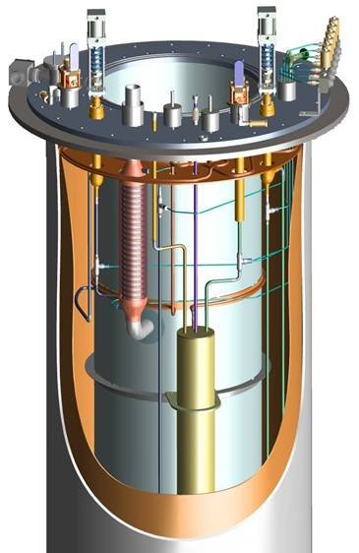
Saturated bath dewar
Simple, in principle
  Essentially a “bucket” of liquid helium
Entirely at saturation pressure
Very stable pressure and temperature
Low heat load due to simple “hanging” construction of LHe vessel
LHe vessel
Thermal shield
Vacuum vessel
CAD rendering of SRF cavity vertical test stand (VTS) at Fermilab

Slide 6
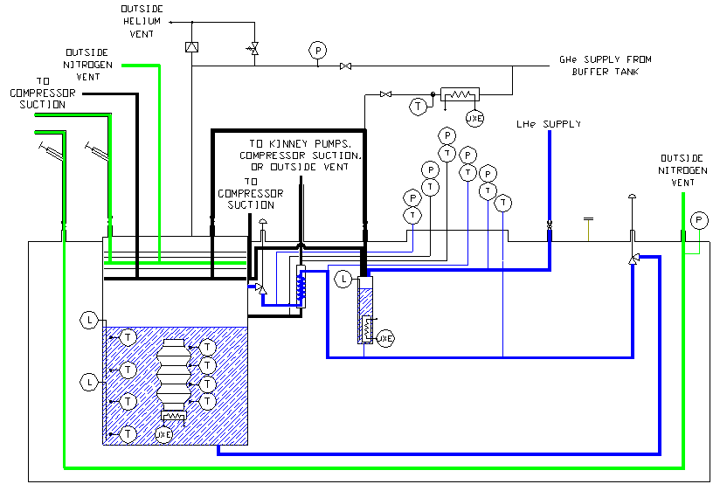
Saturated bath dewar
Thermal shield
Heater controls incoming stream between 4 and 10 K
Vacuum vessel

Slide 7
Saturated bath dewar – some issues
Sub-atmospheric for temperatures below 4.2 K
  Many potential air inleaks
  Air inleak may appear as operational problem without a clear cause
    For example, low pump-down or cool-down rate
Large volume of liquid presents venting problem with loss of insulating vacuum to air
  As much as 4 W/cm² heat deposition on bare surface
  Venting may be a design challenge for a low-pressure vessel (large pipes, etc.)
  We use MLI even under a thermal shield in order to reduce venting flow rate with loss of vacuum

Slide 8
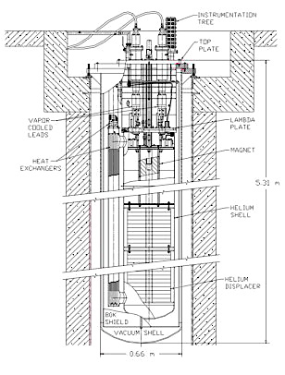
Double bath dewar
Saturated 4.4 K liquid above 1.2 bar, 2 K liquid
  2 K liquid is subcooled, single phase liquid
  Separated by a ‘lambda plate’
Lower heat load to 2 K

Slide 9
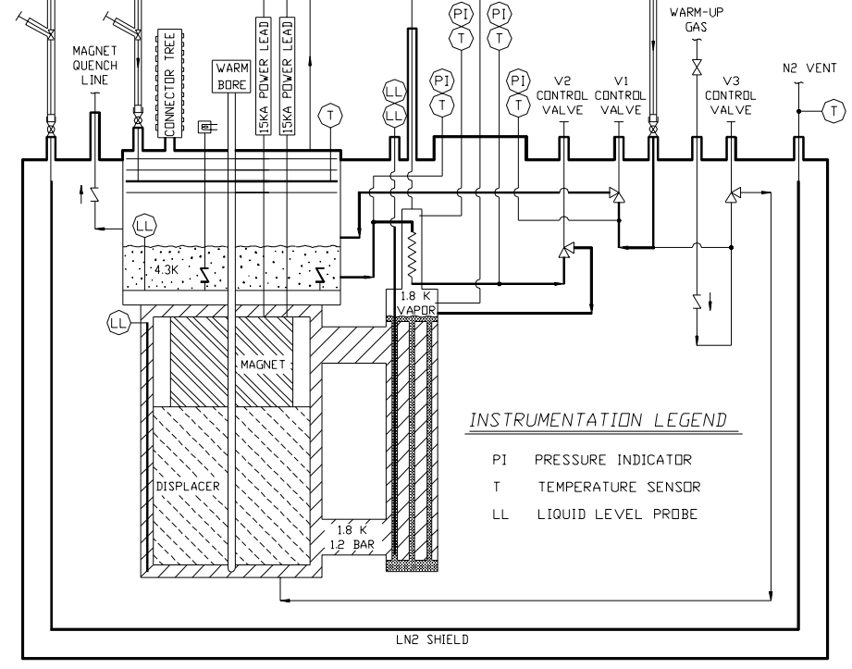
Double bath dewar
Lambda plate
4 K to 2 K heat exchanger

Slide 10
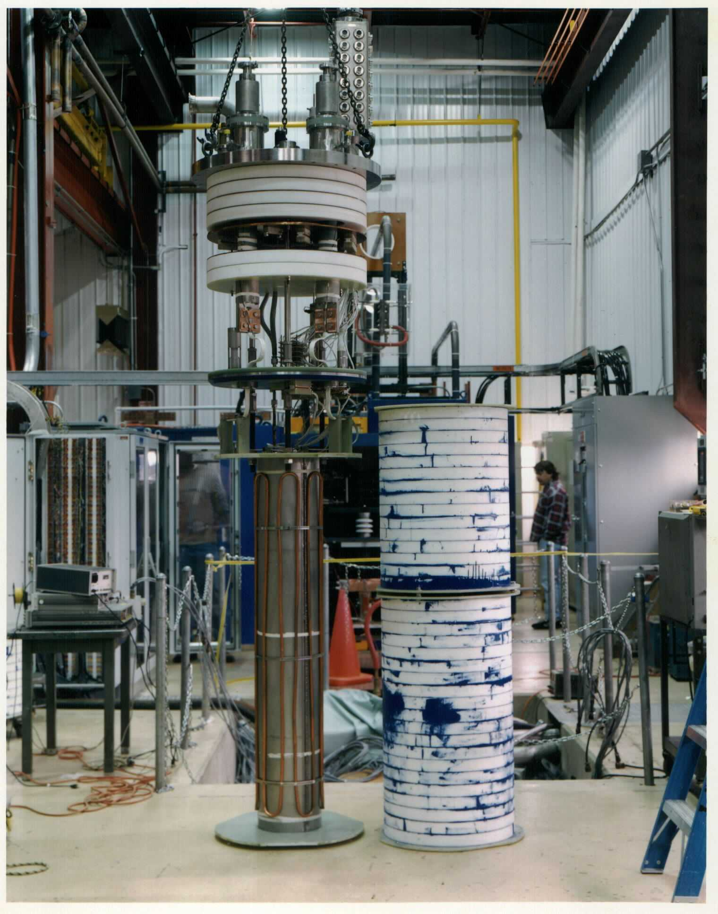
Double bath dewar
Top plate
Closed-foam (Rohacel) insulation
4.4 K vapor space
Lambda plate
Magnet
Double bath dewar for magnet test at Fermilab

Slide 11
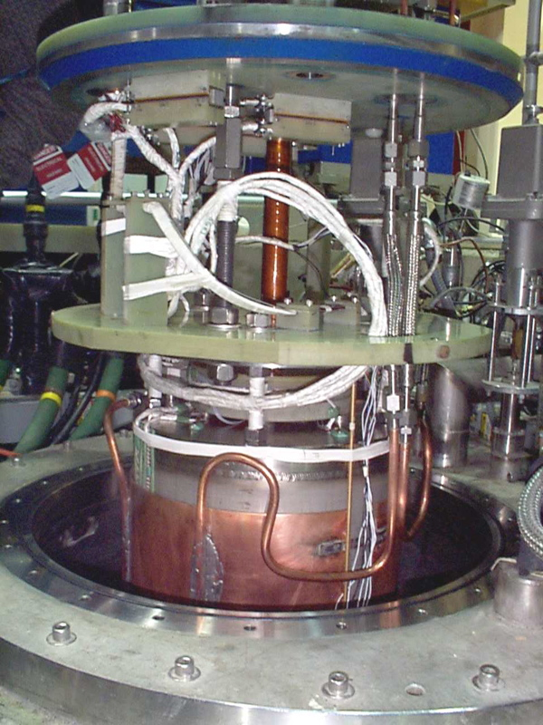
Double bath dewar
Lambda plate and seal (blue)
  Need not be hermetically tight
  Key feature is to provide long, thin path for heat transport
  Flat seal rather than “knife-edge”
Intermediate support plate
Copper cladding around magnet (for cooldown)
Double bath dewar for magnet test at Fermilab

Slide 12
Double bath dewar – some issues
Less amount of superfluid than a saturated bath dewar
  Need to be more aware of heat leaks
Heat transport via a “lambda” seal between normal and superfluid is a problem
  Seal must be tight with long leak paths
  Heat loads come from various sources, so
  difficult to distinguish lambda seal leak
  from others

Slide 13
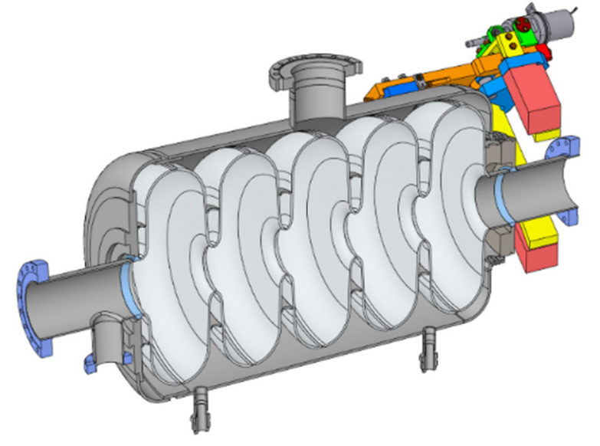
Horizontal test stands
Horizontal -- simply as opposed to vertical orientation of a long magnet or SRF cavity in a typically vertically oriented dewar
Oftentimes used to test "dressed" SRF cavities, such as the one shown on the right
  Source: M. Xu, et. al., Design of Beta=0.65, 5-Cell, 644 MHz Elliptical Cavity for FRIB Upgrade, doi:10.18429/JACoW-IPAC2018-THPAL035
May consist of just end boxes
  A supply box for power and cryogens
  A turnaround box
  Test object in its own cryostat
  Interconnects to the end boxes
Or may be more like a horizontal vacuum chamber
Like vertical test dewars, can provide saturated bath or subcooled liquid
Helium vessel

Slide 14
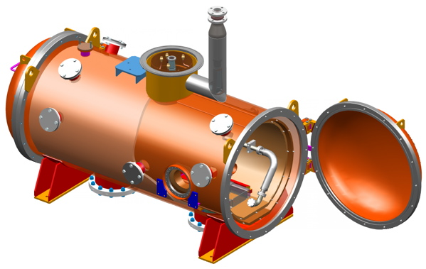
SRF cavity test stand
CAD rendering of vacuum chamber for SRF cavity tests at Fermilab
Designed for tests of RF cavities which are pre-installed into helium vessels

Slide 15
SRF cavity test stand
Helium vessel with RF cavity slides in, then cryo pipes and RF coupler connected
Cavity loading end view of SRF HTS

Slide 16
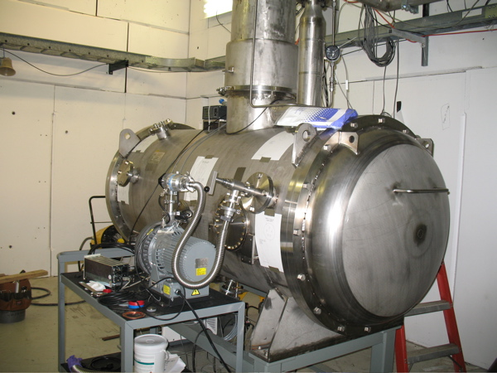
SRF cavity test stand
Stainless vacuum shell
Rubber O-ring seals vacuum door
Copper thermal shields
Cryogenic piping in top
Indium metal seals connect cryogenic piping
Fermilab SRF cavity test cryostat

Slide 17
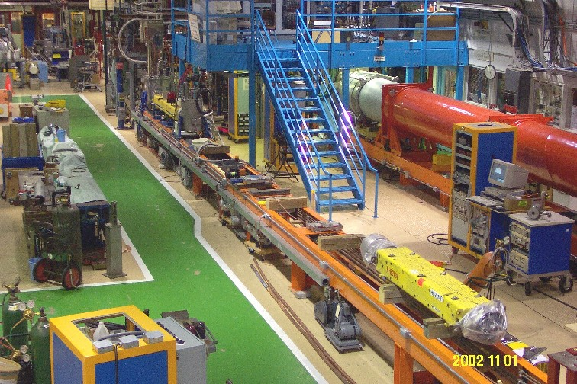
Horizontal test stand for magnets
Magnet test stand 5 at Fermilab
Test stand
Dipole magnet

Slide 18
Horizontal test stand for magnets
Magnet test stand 5 at Fermilab
Fermilab’s first superfluid magnet test stand at commissioned in the 1980’s
Provided stagnant or forced flow operation
  Liquid helium 4.5 K to 1.8 K
Illustrates use of local test stand heat exchangers in combination with large warm vacuum pumps to provide superfluid helium

Slide 19
Providing 2 K on a test stand
Test stand refrigeration requirements are typically small
  A large, 2 K cryoplant will not be available
  4.5 K helium from either a small liquefier or storage dewars will provide refrigeration
  Room-temperature vacuum pumps provide the low pressure for the low temperature helium (below 4.2 K)
  Small heat exchangers may be incorporated for continuous fill duty

Slide 20
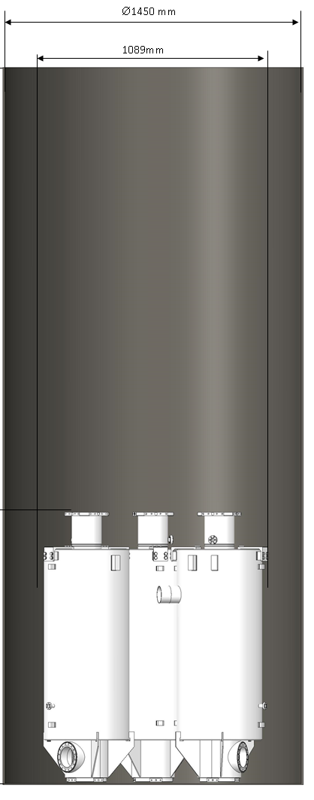
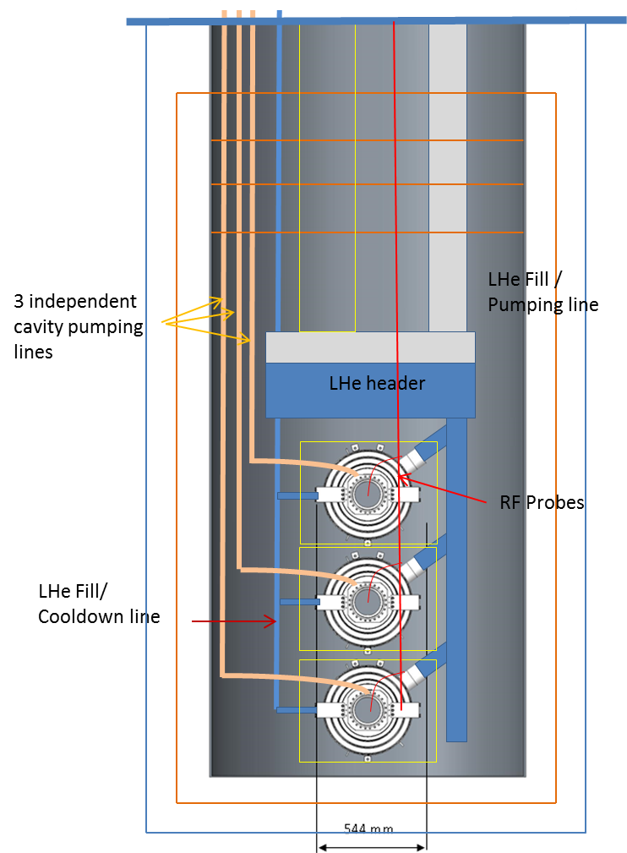
“Horizontal” VTS at STFC Daresbury
2 K RF testing of ESS high-β cavities in a conventional bulk LHe bath cryostat would require ~7500 L LHe per test and GHe handling for ~20 g/s
Instead, developed a VTF that tests 3x jacketed cavities (~50 L each) mounted horizontally and connected to common header tank (~200 L) and fill/pumping line requiring ~1500 L per test with <2 g/s in steady state under static load

Slide 21
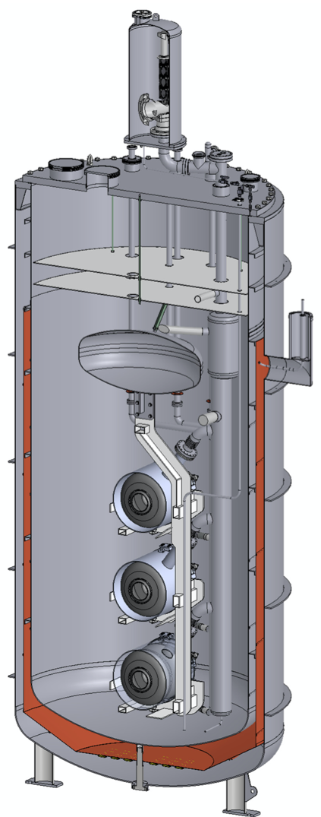
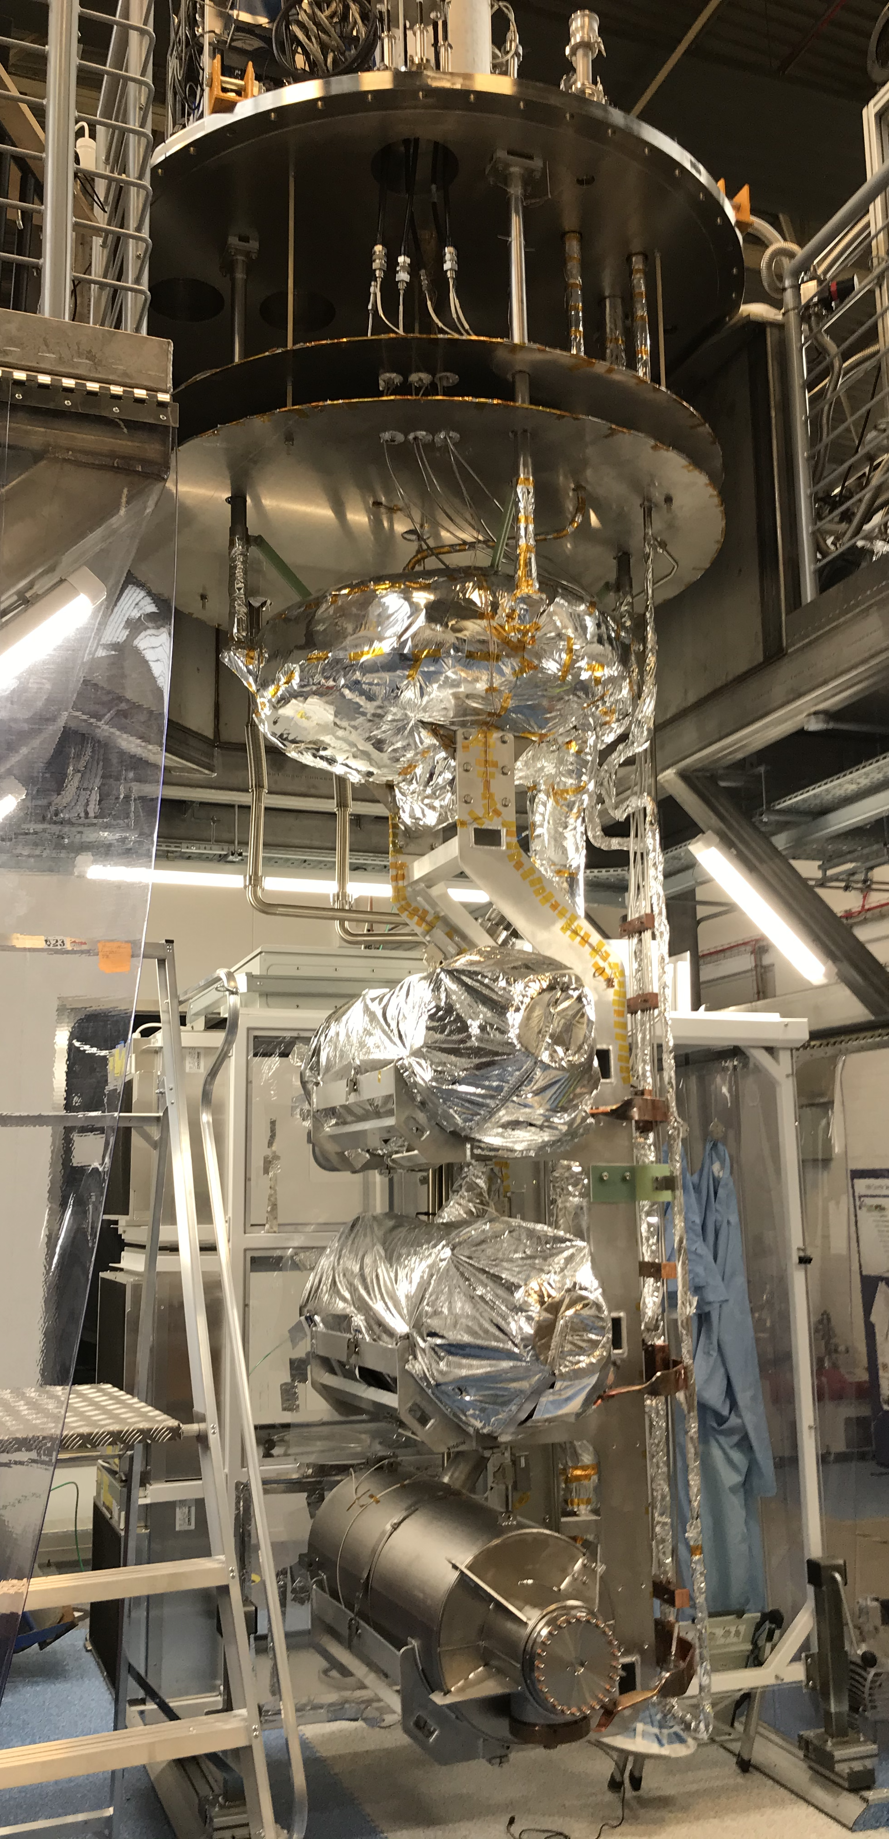
“Horizontal” VTS at STFC Daresbury
Pair of identical inserts with common cryostat (OVC and IVC, thermal shielding, magnetic shielding) to allow simultaneous testing and preparation of next set of cavities
Air Liquide Helial ML cryoplant provides ~130 L LHe/hour and ~2 g/s GHe at 50 K
2 K pumps providing >1 g/s @ 30 mbar (2 K) with additional capacity to be installed 2021
Recovery circuit => closed-cycle

Slide 22
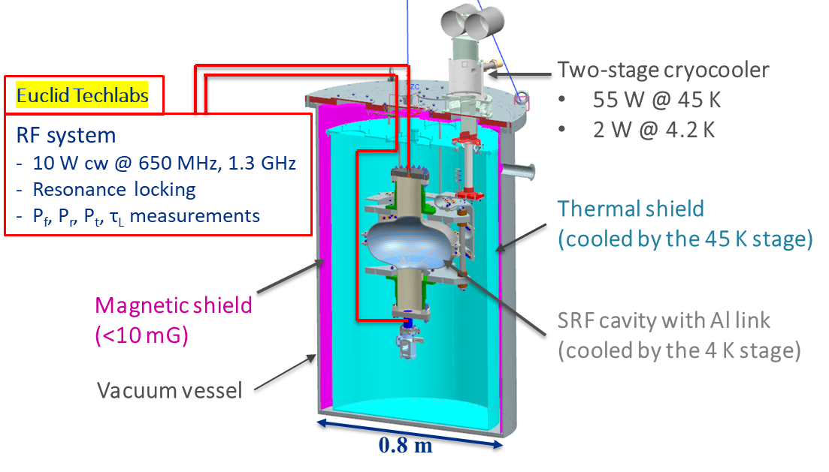
Cryogen-free test stand
Advantages: Simpler pressure-vessel, pressure relief design and no liquid cryogens
Limitation: Cooling power is limited to a few Watts at ~4 K

Slide 23
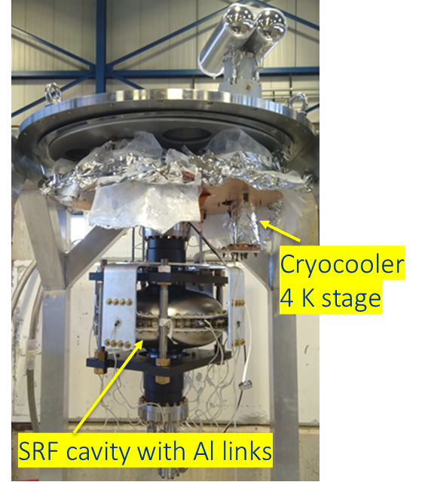
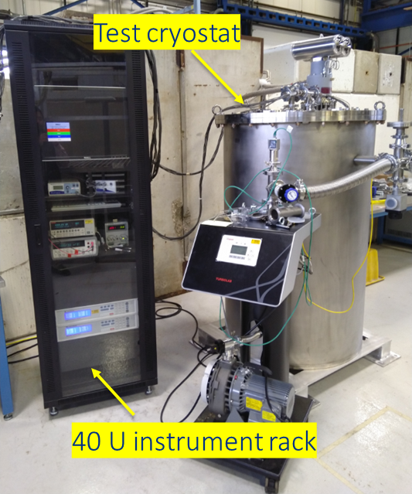
Cryogen-free test stand
4 K cryogen-free test stand at Fermilab

Slide 24
Procurement strategies
Design and build in-house
Design and procure “to print”
Detail interfaces and critical areas but not entire object -- procure to specs and drawings
Performance specification with only a few key interfaces detailed

Slide 25
Procurement strategies
Test vessels and stands with end boxes are typically unique -- one or a few-of-a-kind
Industry is small and specialized
Designs often contain new, risky, or erroneous features
Close collaboration with a vendor is critical
  Frequent (once per week or more) inspections and meetings at the vendor

Slide 26
Design, procurement, installation timescales
Design of a new cryogenic box
  0.5 or more man-years engineering
  1.0 or more man-years drafting
  Typically 6 - 9 months calendar time
Procurement -- another 6 - 12 months
Installation
  Complexity of instrumentation, controls, interfaces are often underestimated
  Several months
Result -- two years or more

Slide 27
Operations
Common problems encountered
  Warm gas in adds large amount of heat
    A very small leak via a valve isolating warmer helium from the lower temperature system may be a hidden source of heat
    1 mg/sec at 300 K ==> 1.5 Watts to 4.5 K!
  Air leak in (contamination)
    Sub-atmospheric operation for <4.2 K provides risk of air inleaks, especially through instrumentation and other seals

Slide 28
More on operations
Instrumentation
  Generally allow a period of “thermal studies” upon startup of a new test system
    Check instrumentation
    Review operating procedures
    Verify thermal performance

Slide 29
References and further reading
  P.O. Mazur and T.J. Peterson, “A Cryogenic Test Stand for Full Length SSC Magnets with Superfluid Capability,” Advances in Cryogenic Engineering, Volume 35A, pg. 785.
  T. J. Peterson, et al, “A 1400 Liter 1.8 K Test Facility,” Advances in Cryogenic Engineering, Volume 43A, pg. 541.
  R.H. Carcagno, et al, “A Cryogenic Test Stand for LHC Quadrupole Magnets,” Advances in Cryogenic Engineering, Volume 49A, pg. 225.
Pattalwar, S., et al. "CRYOGENIC PERFORMANCE OF THE VERTICAL CRYOSTAT FOR QUALIFYING ESS SRF HIGH-BETA CAVITIES." 19th International Conference on RF Superconductivity (SRF'19), Dresden, Germany, 30 June-05 July 2019. JACOW Publishing, Geneva, Switzerland, 2019.
Bizel-Bizellot, L., et al. "Cryogenic safety considerations for Vertical Test Facility for qualifying high-β SRF cavities for the European Spallation Source." IOP Conference Series: Materials Science and Engineering. Vol. 502. No. 1. IOP Publishing, 2019.
Smith, P. A., et al. "ESS High Beta Cavity Test Preparations at Daresbury Laboratory." SRF17, Lanzhou, China (2017).
R C Dhuley et al 2020 IOP Conf. Ser.: Mater. Sci. Eng. 755 012136

